Slide 1

Explain networking devices and operations.

Slide 2
Chapter Objectives
Explain NIC
Explain Hub
Explain Switch
Explain the working of switch
Explain Router and features of routers
Explain Gateway

Slide 3
Networking devices
Servers; hub, routers; switches; multilayer switch, firewall, HIDS, repeaters; bridges; wireless devices; access point (wireless/wired), content filter, Load balancer, Modem, Packet shaper, VPN concentrator.

Slide 4
Networking
Software:
Client software, server software, client operating system, server operating system, Firewall

Slide 5
Server type:
Web, file, database, combination, virtualization, terminal services server.

Slide 6
Server selection:
Cost, purpose, operating system requirement

Slide 7
Workstation
Hardware e.g. network card, cabling; permissions; system bus; local-system architecture e.g. memory, processor, I/O devices.

Slide 8
Networking Devices
Networking devices interconnects networks
Manage data flow and network traffic
Networking
Devices
Repeaters
Hubs
Bridges
Switches
Routers
Gateways
Other
Devices

Slide 9
Network Interface Card (NIC) - I
In a network, to send the data the node requires the destination address.
In a network, each node should have its own address to send and receive their data.
This address is known as physical or MAC (Media Access Control) address.
It is provided by a device known as Network Interface Card (NIC) and it operates at layer 2 of the OSI model.

Slide 10
Network Interface Card (NIC) - II
A Network Interface Card (NIC) is a hardware device that is used to connect a node onto a network.
NIC is fitted into the expansion slot inside the computer. It serves as a link for sending and receiving data on the network.
It can support a transfer rate of 10, 100 or 1000 Mbit/s. The user can select an NIC depending on the type of network, protocol and media.

Slide 11
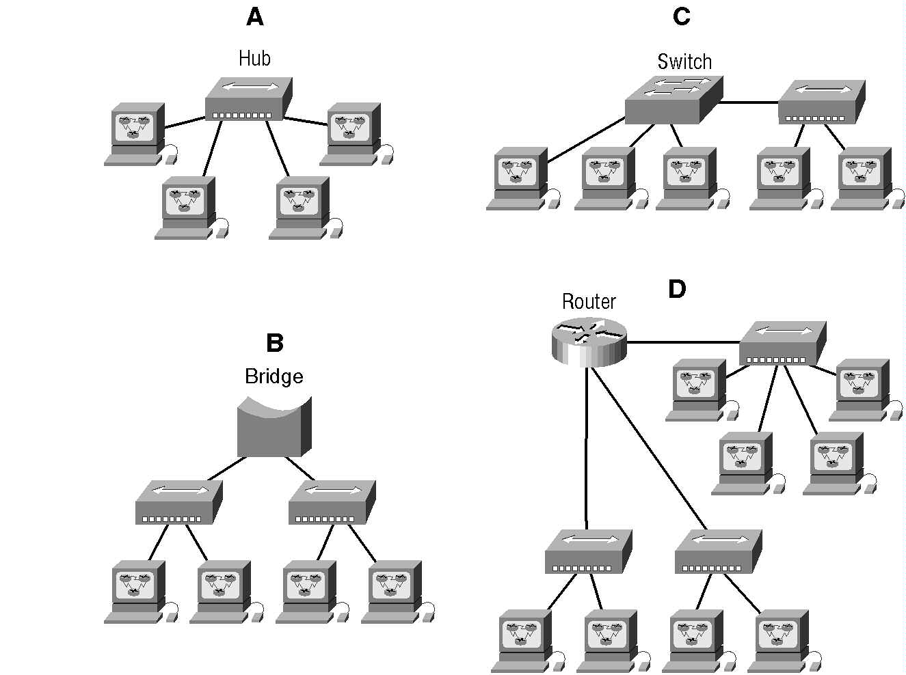

Slide 12
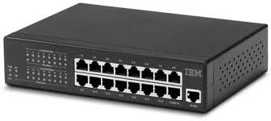
Hub
Simplest and low cost device
Also known as Multi-port Repeater
Operates at Physical Layer like Repeater
Transfers data to all the ports

Slide 13
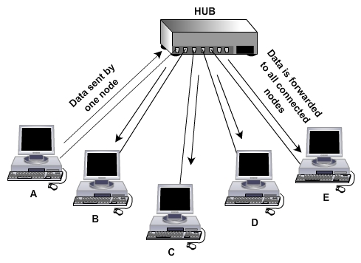
Operation of Hub

Slide 14
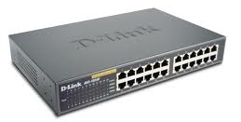
Switch
Provide signal flow management
Replace slower hub
Being a Data Link Layer device uses MAC address for data transfer
Data transfer to specific port

Slide 15
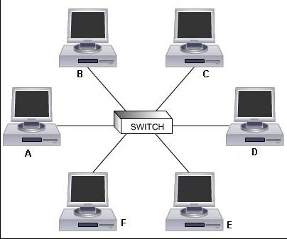
Switch in a Network

Slide 16
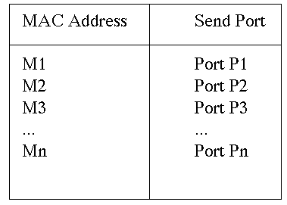
Working of Switch
When switch receives data from one of the connected devices, it forwards data only to the port on which the destination system is connected.
Uses the Media Access Control (MAC) address of the devices to determine the correct port.
Refers to MAC table which stores MAC address with corresponding port number.

Slide 17

Frame Structure
6 Bytes
6 Bytes
1500 bytes
4 Bytes

Slide 18
Connecting Ethernet Segments - I
Multiple switches are useful in the network for redundancy and network expansion.
Maximum number of ports available on switch are 48; this restricts the number of users that can be connected to the switch.
To include more users than the available ports on switch, another switch is required.
This switch should be connected to the previous switch for the data transfer between two segments.

Slide 19
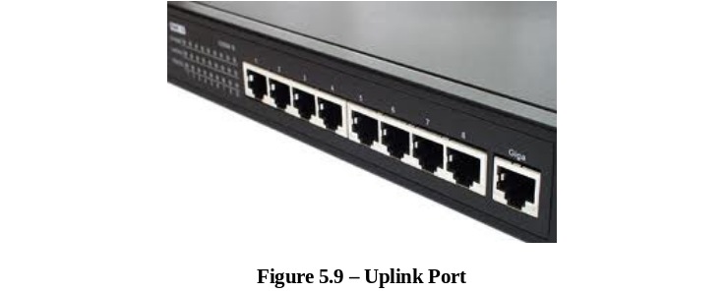
Connecting Ethernet Segments - II
A crossover cable is required to connect two or more switches.
Crossover ports are also known as uplink, in port or out port.
Crossover cable allows you to connect two computers together using 1000Base-T NICs without a switch in between.
Uplink

Slide 20
Multispeed Switches
Having number of ports such as 100 Base T and one or two gigabit ports
Port detects the speed of NIC and runs at that speed is called auto sensing
Port runs at 10, 100 or gigabit is referred to as 10/100/1000 port

Slide 21
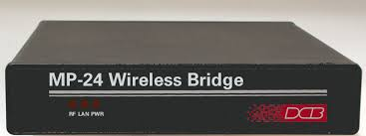
Bridge

Slide 22
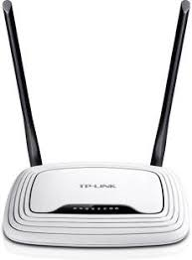
Router

Slide 23
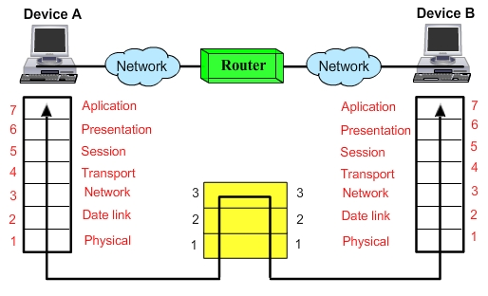
Router
Operate at Network Layer of the OSI model
Can connect nearer or far network segments

Slide 24
Routers - II
Works in LAN, MAN and WAN environments
Having LAN and WAN ports
WAN port connects to regular phone line or more advanced telephone connection like ISDN, ADSL, T1 or may be a cable modem
Route the packets seeing the IP address stored in the packet
Comes in variety shapes, sizes and functions

Slide 25
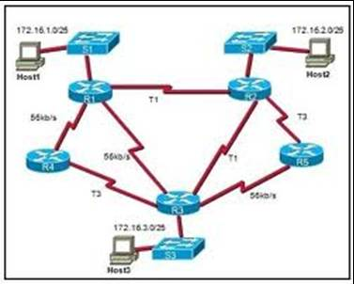
Routers in a Network

Slide 26
Ethernet Card - I
Ethernet cards are of two types:
  Wired
  Wireless
Different types of Wired Ethernet cards can be used depending on the type of network and corresponding connector that is required. The different types of Wired Ethernet cards are:
  1000BaseT NIC
  Fiber – optic NIC

Slide 27
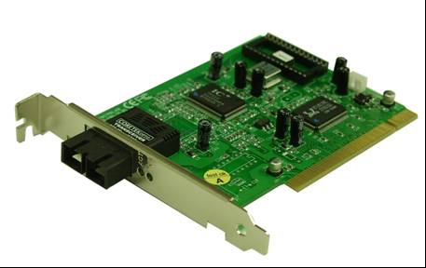
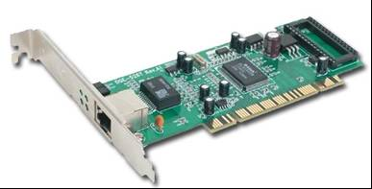
Ethernet Card - II
1000BaseT NIC
Fiber optic NIC

Slide 28
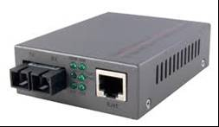
Fiber to UTP
Converter

Slide 29
Gateway - I
Is a networking device which acts as an entrance (or a gate) for another network.
In enterprises, the gateway is the computer that routes the traffic from an internal network to the outside network.
The gateway node often acts as a proxy server or a firewall or a router.
A default gateway is the one that meets the following criteria:
  It is on the same subnet as your computer.

Slide 30
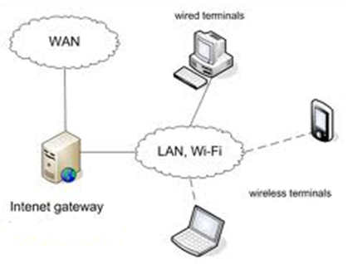
Gateway - II
  It is the gateway that your computer depends upon when it does not know through which route to send the traffic towards destination.
Gateway works at all levels of the OSI model

Slide 31
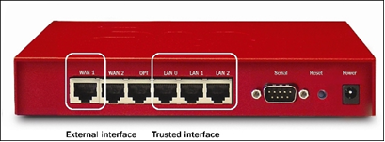
Gateway - III
The gateway has two sides, WAN side and LAN side.
The WAN side connects to modem and therefore to the Internet via ISP and the LAN side connects to the network via hub or switch. So, while configuring gateway you need to configure both WAN and LAN sides.
Firewall is a gateway device.

Slide 32
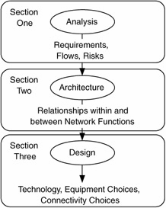
Design Efficient
Network
Designing a network is typically broken into three sections:
  Determine requirements
  Define the overall architecture
  Choose technology and specific devices

Slide 33
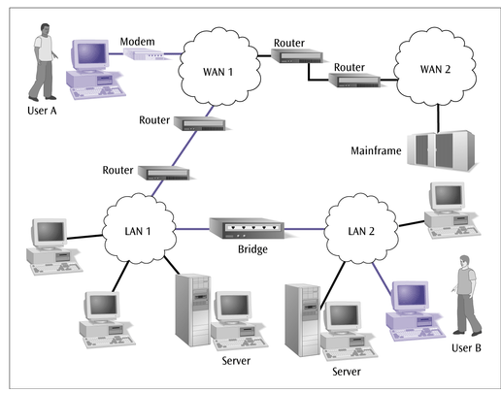
Implement & diagnose networked systems.

Slide 34
Question Time Limit – 2 Mins
List the different types of networking devices.

Slide 35
MAC Addressing
Operates at the data link layer of the OSI model.
Is a 12 digit hexadecimal number (48 bit address).
Is made up of numbers from 0-9 or a letter from A-F.
Can be written in any one of the formats:
  MM:MM:MM:SS:SS:SS
  MM-MM-MM-SS-SS-SS

Slide 36
MAC Address
The MAC address is divided in two parts.
The first part of the address gives information about the adapter manufacturer.
It represents the ID number of the manufacturer.
The second half of the MAC address represents a serial number for that NIC provided by the manufacturer.

Slide 37
Practical - I
Perform activity at the end of this chapter.
  To check the Media Access Control (MAC) address of your PC.

Slide 38
Practical - II
Perform activity at the end of this chapter.
  To identify different types of switches.

Slide 39
Question Time Limit – 3 Mins
What is the difference between a switch and router?

Slide 40
Practical - III
Perform activity at the end of this chapter.
  To identify a router.
  To configure gateway in a client PC.

Slide 41
Summary - I
MAC address is a 12 digit hexadecimal number (48 bit address).
Mac address is provided by a device known as Network Interface Card (NIC) and it operates at layer 2 of the OSI model.
A hub is a Repeater with multiple ports simply receives the data from one port and sends the data to all the ports.
Now a day’s switches are mostly used in LAN due to their superior throughput performance, higher port density, lower per-port cost and greater flexibility.

Slide 42
Summary - II
When switch receives data from one of the connected devices, it forwards data only to the port on which the destination system is connected.
Router is an intelligent Network layer (layer 3) device which connects two or more network segments which may be near or very far and having different types of cabling.
Gateway is a networking device which acts as an entrance (or a gate) for another network.

